Slide 1

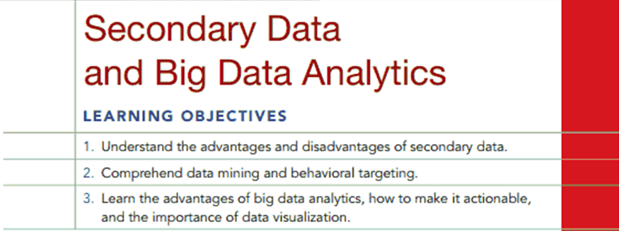
Chapter Four Q and A
4-1

Slide 2
Question
Why has big data analytics become so popular with firms like United Airlines, American Express, and Ford Motor Company?

Slide 3
Answer
All major firms collect data related to customer shopping, transactions, and customer service feedback. Big Data analytics uses statistical and other mathematical software tools to discover non-obvious patterns of preference and behavior that might be hidden in these databases. The objective of this analysis is to identify information that marketers can use to formulate strategies and tactics to increase the firm’s profitability.

Slide 4
Question
It has been said that big data analytics turns the scientific method on its head. What does this mean?

Slide 5
Answer
Traditionally, marketing research has started with problem recognition, well defined problems and methods of collecting data in which the market researcher has a lot of control over. The data is put neatly into rows and columns in a statistical database, and the market researcher can analyze those relationships defined by the research study objectives. With big data analytics, however, the process is more discovery oriented. The software can analyze data patterns in the database and utilize data in a form in which was not possible with traditional statistical analysis. Hence, the traditional steps of the scientific method are not followed as they once were.

Slide 6
Question
Why are secondary data often preferred to primary data?

Slide 7
Answer
Secondary data are already collected, so access should be much faster. Secondary data should be less costly to obtain than primary data. In some cases, as when investigating historical events, secondary data is all that is possible to obtain.

Slide 8
Question
Read
  REAL-LIFE RESEARCH 4.1 The Interesting and Curious World of Nate Silver
Q: Will be data analytics put marketing researchers out of business? Why? More precisely, will mathematical algorithms replace marketing researchers?

Slide 9
Answer
The ability to make output usable for more managers, those without extensive training in statistical analysis will not terminate traditional marketing research. There will always be a need for people who understand the basic concepts of marketing research, and be able to translate broad management problems into more precise marketing research problems. Big Data is just a tool. There still has to be somebody with knowledge of what the tool is doing to facilitate the interpretation of the output.

